Slide 1
The Future of Accessible Work: Trends, Technology & Policy
Josh Christianson, Project Director, PEAT
Jutta Treviranus, Director, Inclusive Design Research Centre, OCAD University
Notes:
1

Slide 2
Agenda
Introductions
Gig Economy
Artificial Intelligence
Policy and Regulations
Resources
Discussions
2
Notes:
2

Slide 3
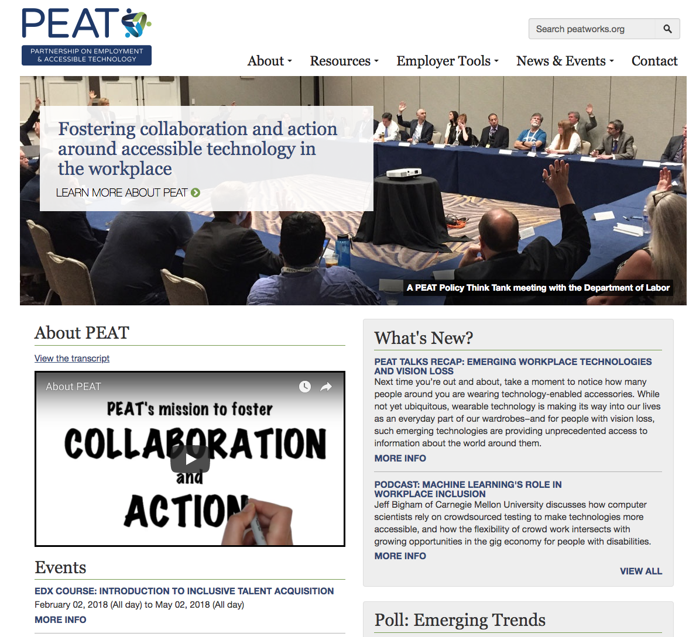
About PEAT

Slide 4


The Inclusive Design Research Centre
inclusive design of emerging sociotechnical systems and practices
or... digital inclusion and designing for diversity
since 1993
open source, open access, open standards, open data
over 96 research partner organizations globally
Inclusive Design Institute -
inclusive infrastructure
2

Slide 5
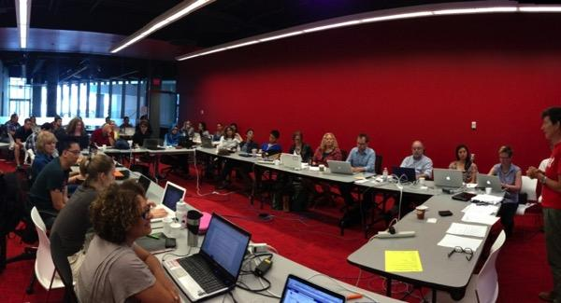

Masters in Inclusive Design
an experiment in inclusive design
as diverse a cohort as possible
Students as co-creators of their own learning experience
function as a "post-disciplinary" team
2 year executive masters with blended delivery
a growing global learning community
DEEP conference: http://deep.idrc.ocadu.ca
4

Slide 6
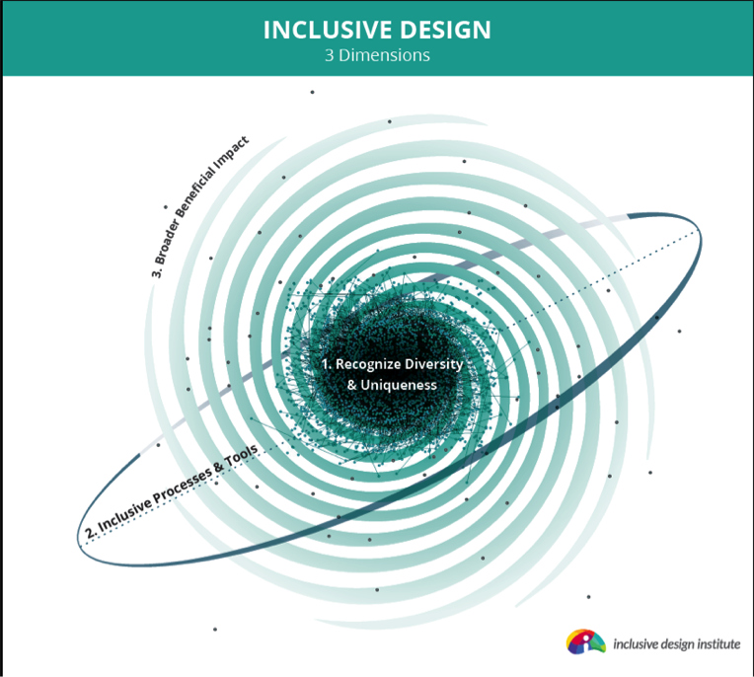
Inclusive Design..
One-size-fits-one - recognizing diversity
Inclusive process – co-design – diverse team
Benefit-for-all - intervention in complex adaptive system

Slide 7

Gig Economy
"The gig economy...is now estimated to be about 34% of the workforce
and expected to be 43% by the year 2020"
-Intuit CEO Brad Smith
Accessibility implications
Freelance work that can be done from home is a big opportunity for PWD to generate income and have flexibility.
Gig workers with disabilities don’t have same rights as full-time employees to request reasonable accommodations if the work isn’t accessible.
Related tools
Platforms like Mechanical Turk and TaskRabbit pay by the project allowing gig workers to complete small tasks like transcribing an audio transcript, entering in information into a spreadsheet, or organizing data.
7
Notes:
7

Slide 8
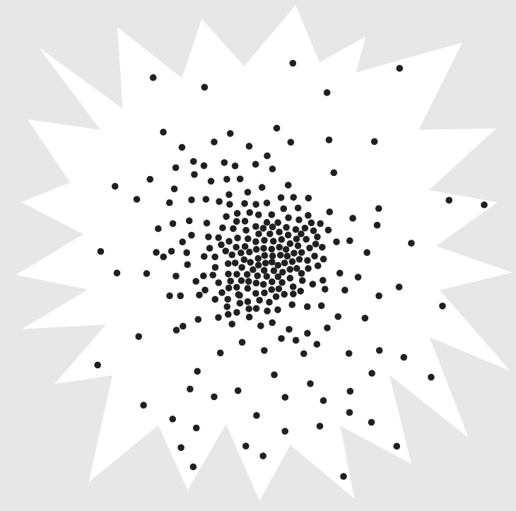
Starburst Scatterplot

Slide 9
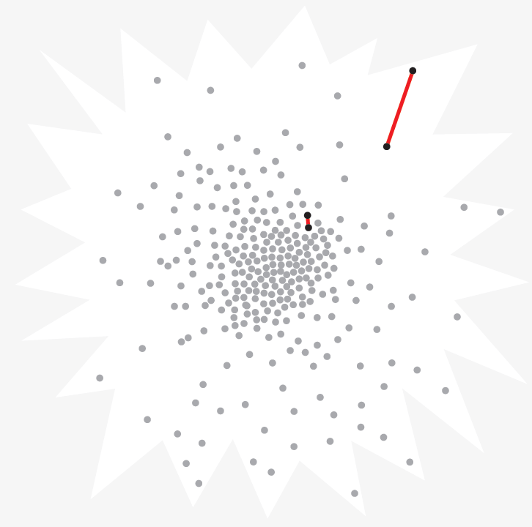
Scatterplot with Line Differentials

Slide 10
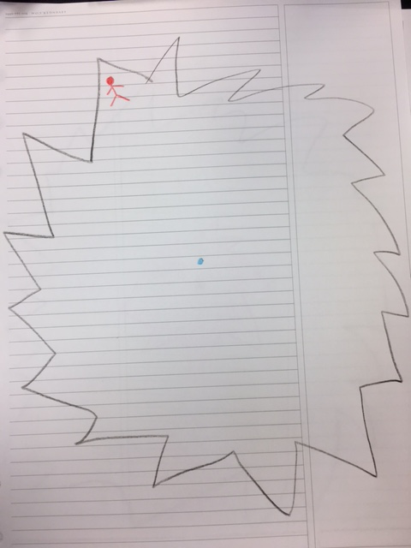
The injustice of the market and the minority
Individuals with disabilities are people that are different
In the scatterplot of human needs…..
…what happens at the jagged edge?

Slide 11
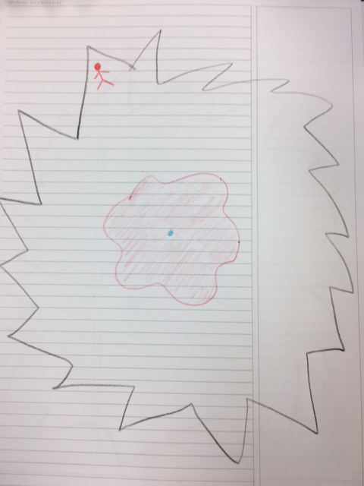
Design for the Average
Products not made for you
Any that are made for you cost more
You have less degrees of freedom to adapt to a design that doesn’t fit
More important that the design is optimized for you

Slide 12

Starburst Scatterplot with Shapes Outlined

Slide 13


Stranded at the edges…
Falling through the cracks…

Slide 14
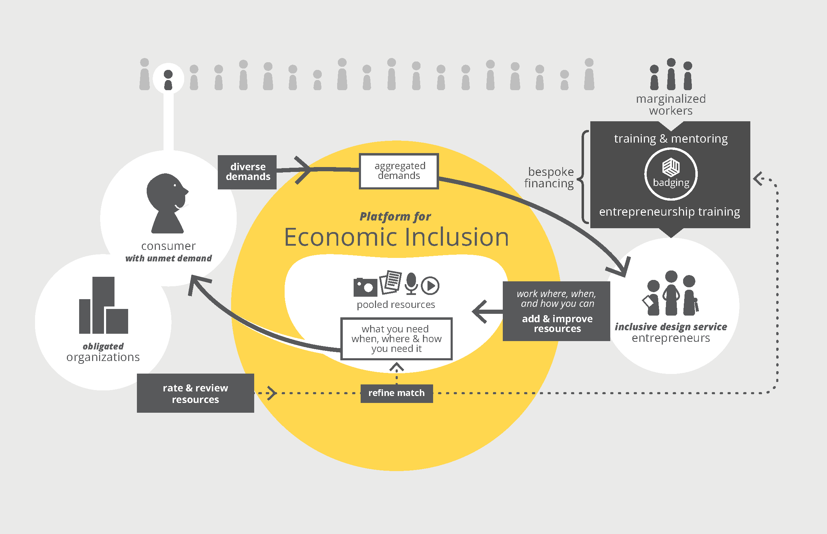
Platforms for Economic Inclusion
9

Slide 15
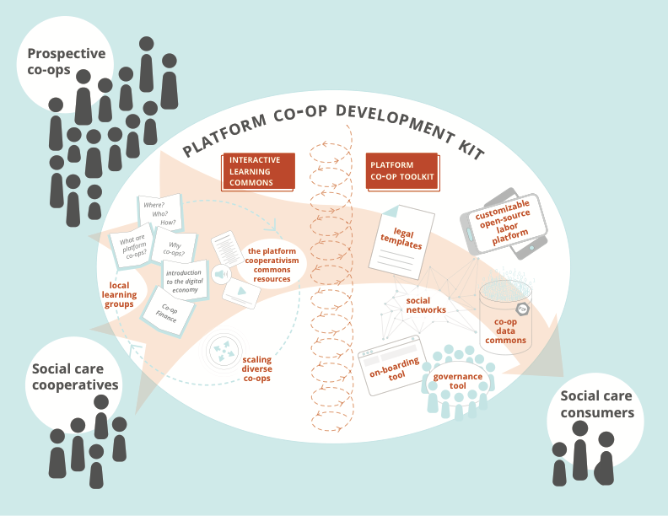
Platform Coop Development Kit

Slide 16
AI + HR
Huge growth in promotion and adoption of machine learning within the field of Human Resources
Big data on the cloud is able to be searched quickly which can help recruiters sort applicants and contacts quickly
Automatic messaging and the rise of chat bots in recruiting
Pattern recognition and look at current job descriptions and analyze hiring success from the past to look for good new hires
Machine learning can scan employees for good fits for promotions or skills gaps/training needed

Slide 17
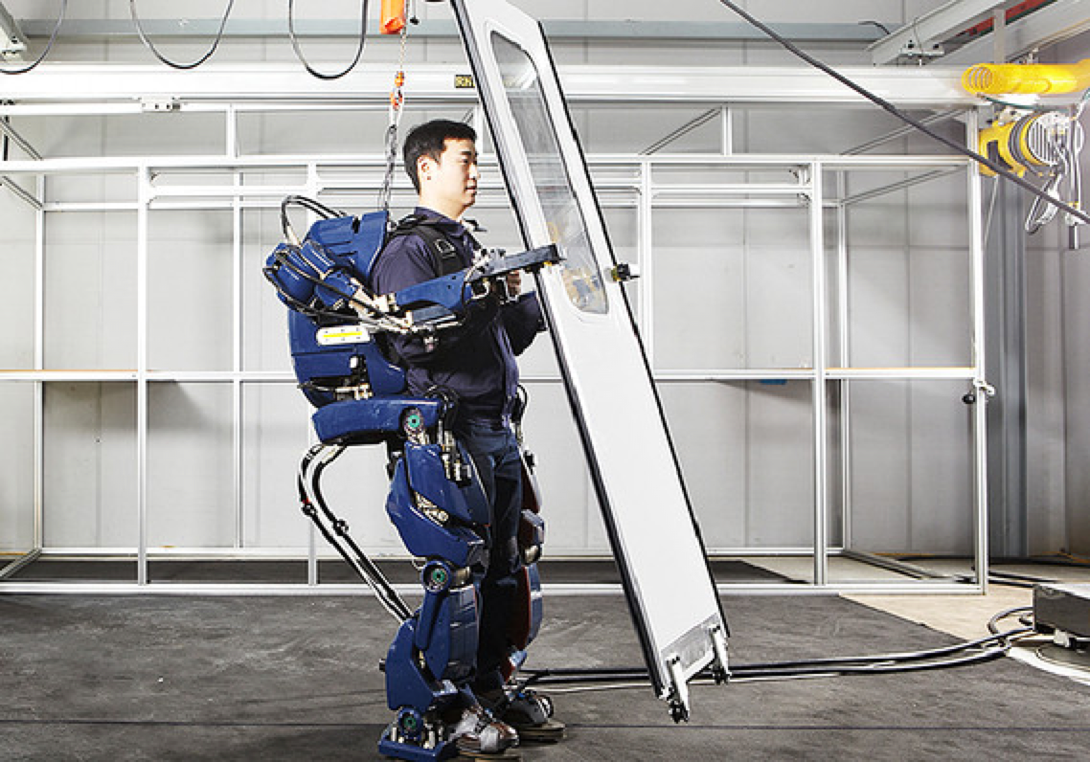
AI and Work
Augment
Replace
Automate
But more importantly:
filter
sort
decide

Slide 18
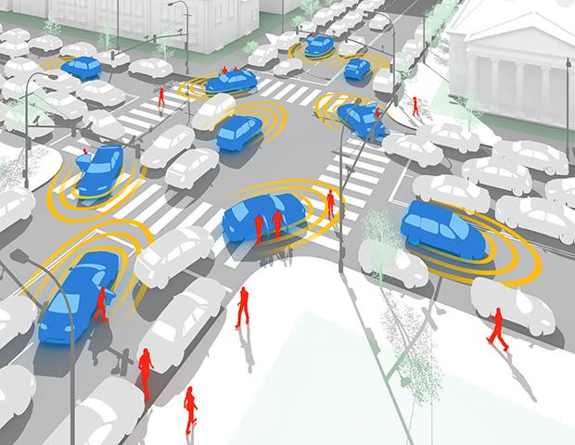

Alice and the unexpected…

Slide 19

Smarter is not always better…

Slide 20
“Progress” is not always helpful…

Slide 21
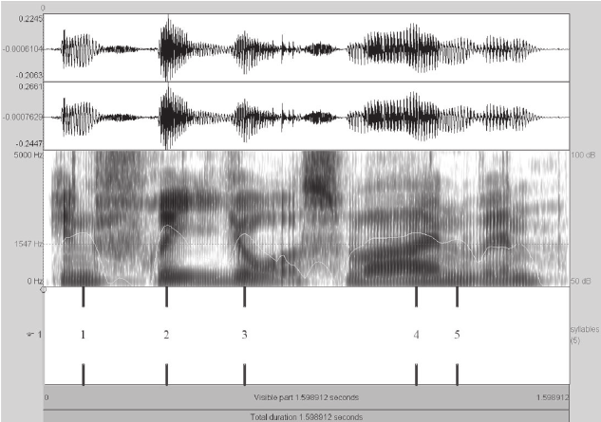
Early speech recognition…

Slide 22
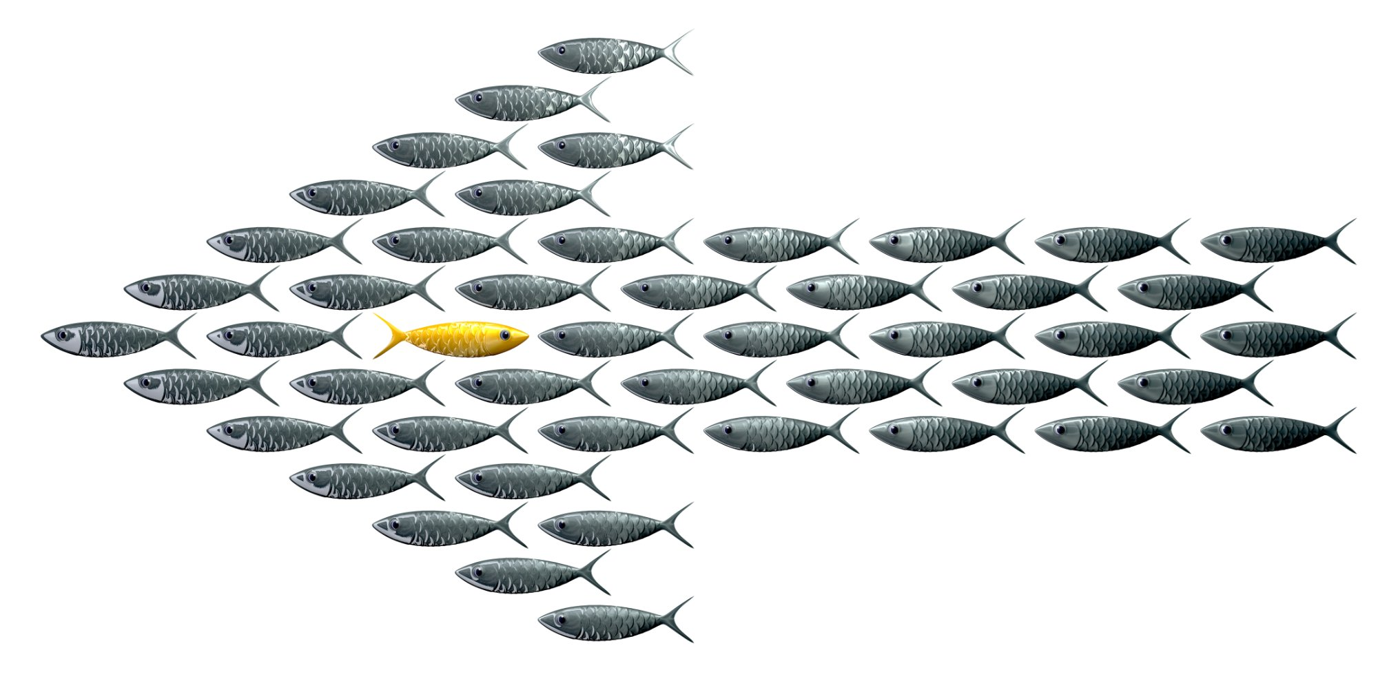
Fighting pervading models…

Slide 23
Why is this happening??

Slide 24

Data Cleaning & Processing
Outliers
Noise

Slide 25
What lies are we telling our machines?

Slide 26



Myth #1: the norm
people can be treated as a mass
most people are represented by the notion of an average human
if necessary, categories based on single characteristics can be used to sort humans

Slide 27

Myth # 2: a winning approach
Reductionism is necessary and holds no appreciable risk
we must determine a “best” or “winning” approach
impact should be measured based on the largest homogenous numbers

Slide 28

Myth #3: Data doesn’t lie
You can predict the future based on the past
Machines are objective
Reliving the myth of mechanical objectivity

Slide 29

In fact…
no average human
no average us
Jagged spectrum at every level

Slide 30
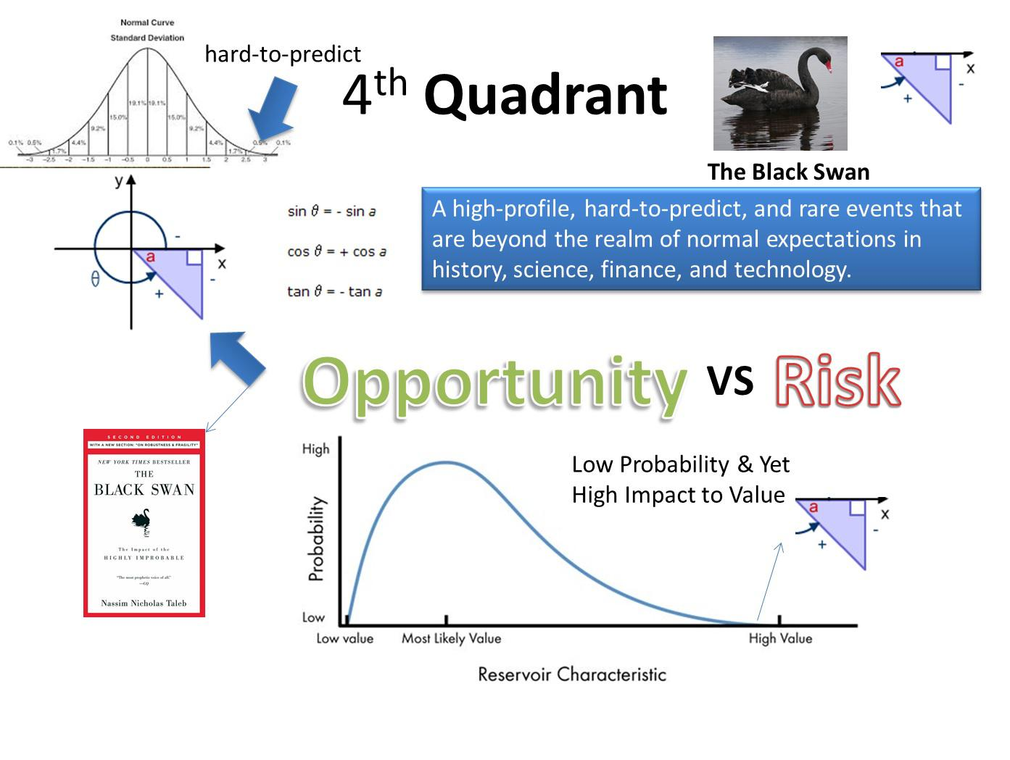
..the biggest disruptions are black swans..
data about the past is poor at predicting the important events of the future

Slide 31
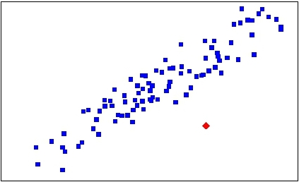
…innovation is found at the edges

Slide 32
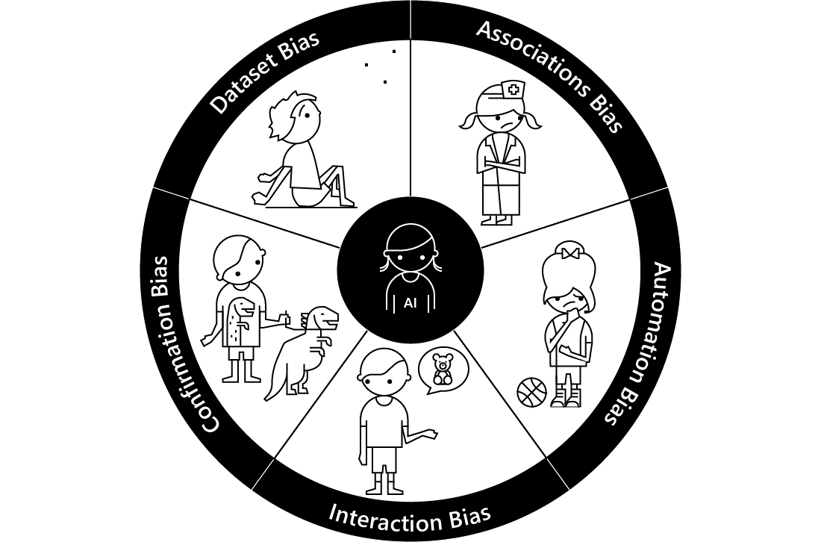
Understanding Bias…

Slide 33
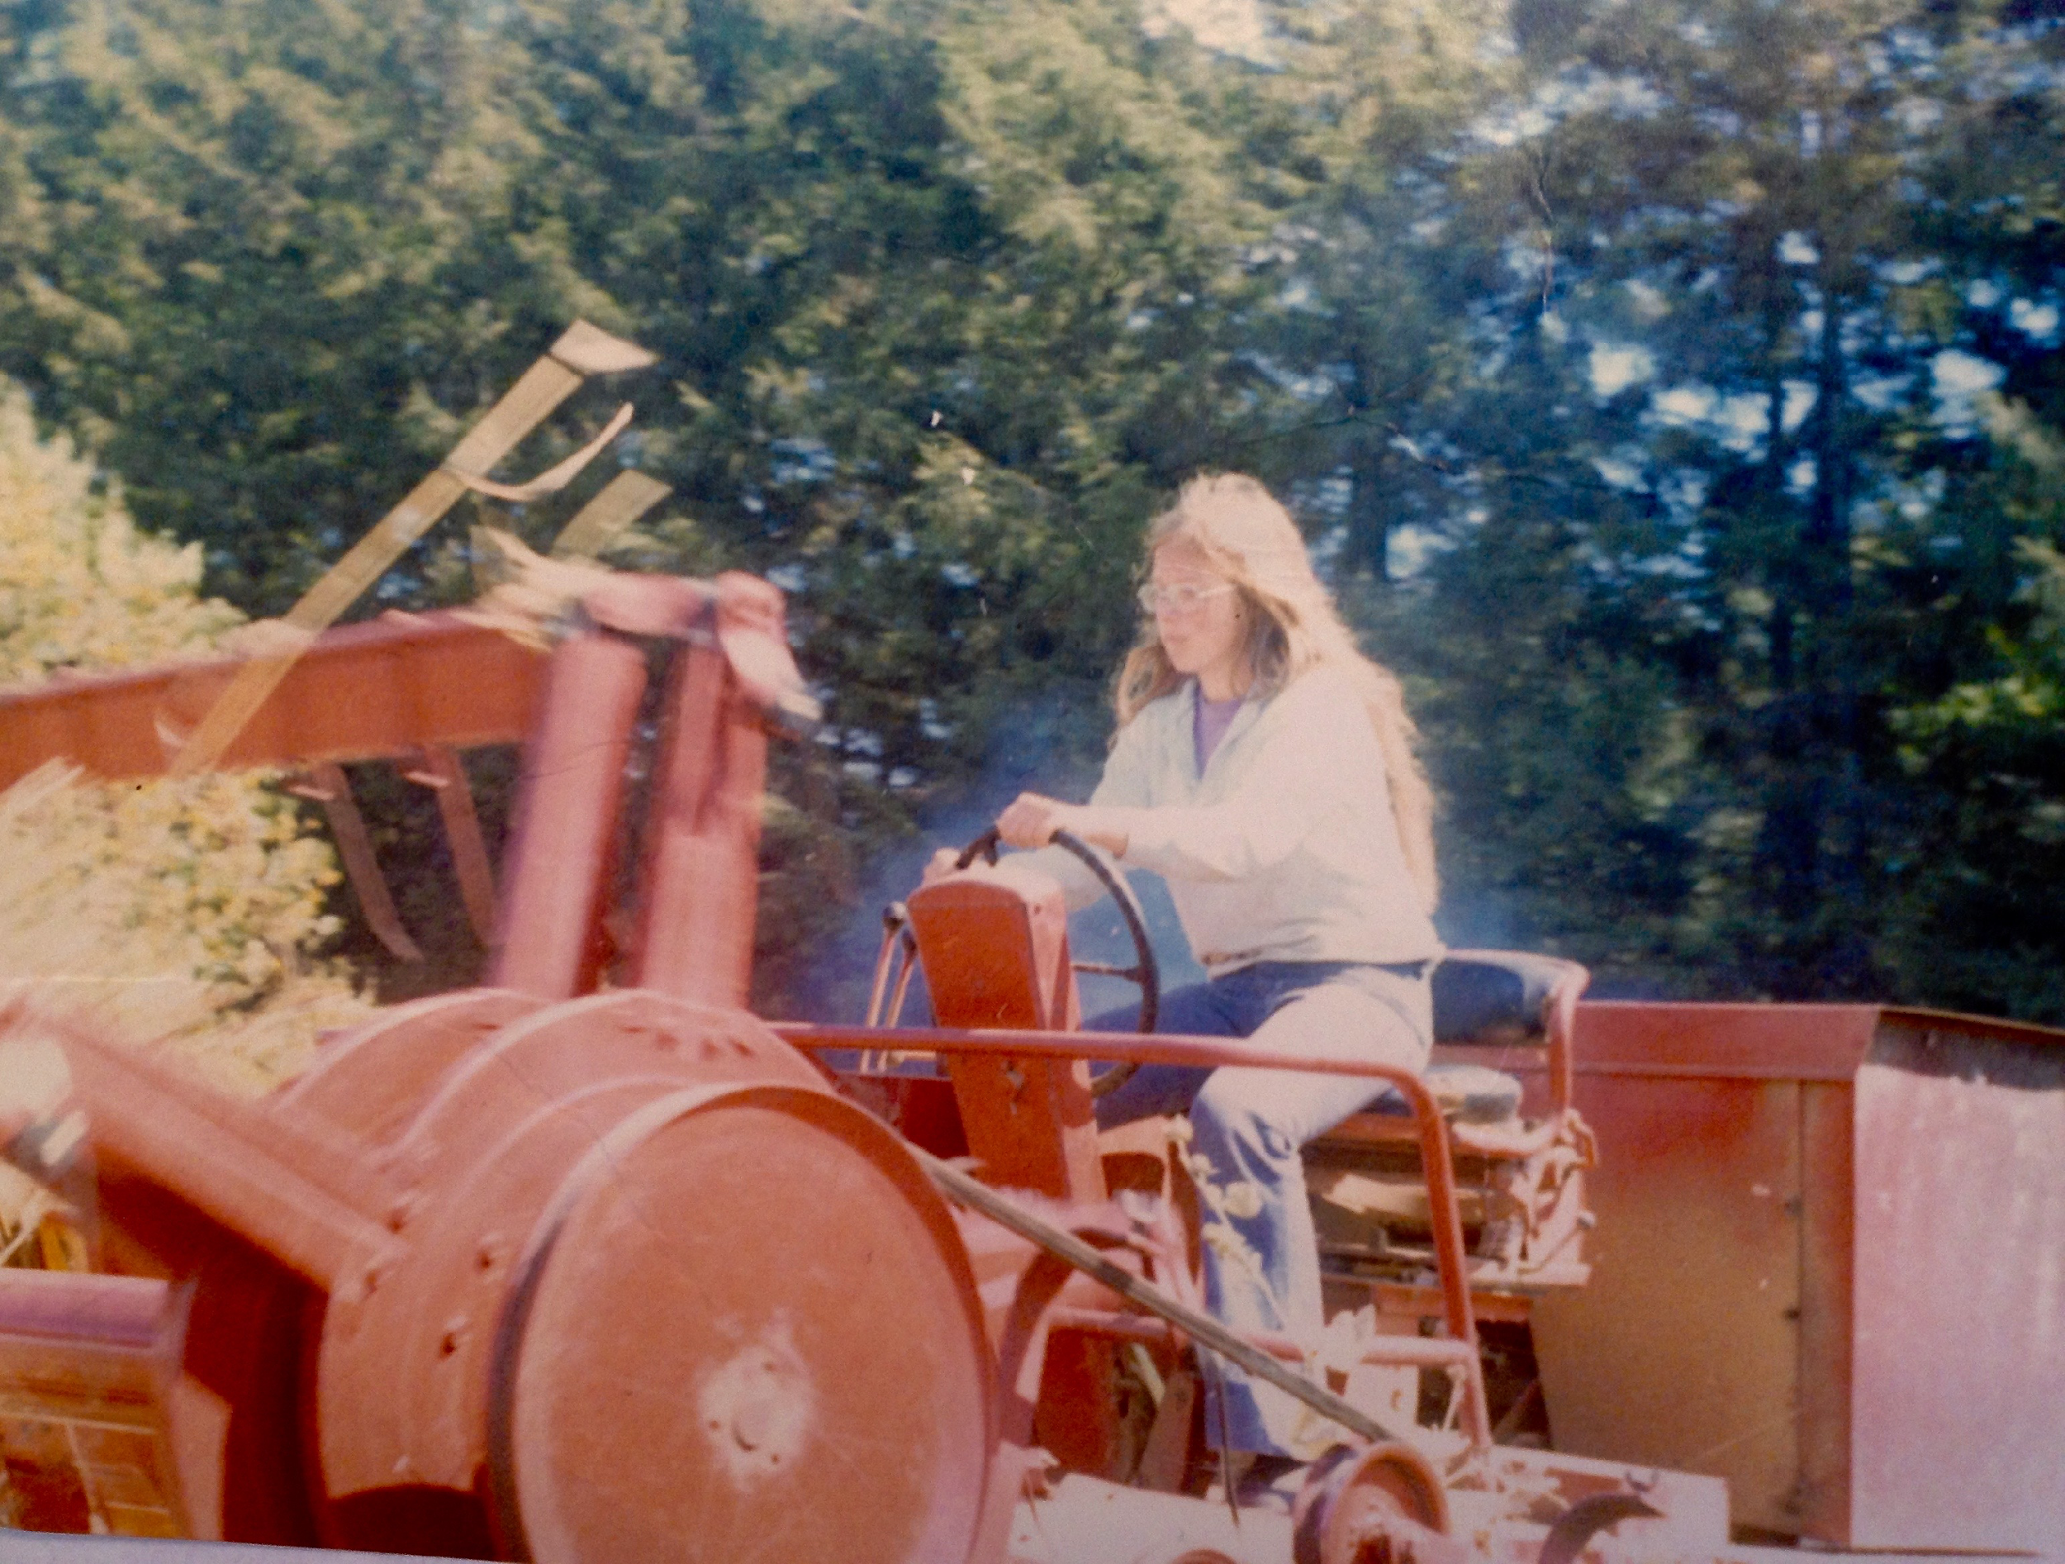
Future of Work, “Data Driven” Companies Privacy
constant monitoring
Personal Privacy Preference standard (ISO 24751-5)

Slide 34
N=me research
http://smalldata.io
Personalized data

Slide 35
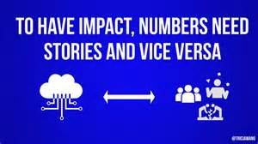
Thick Data
Data with context

Slide 36

“Start your machine learning engines & race to the edge”
https://bigidea.one/design-challenges/

Slide 37
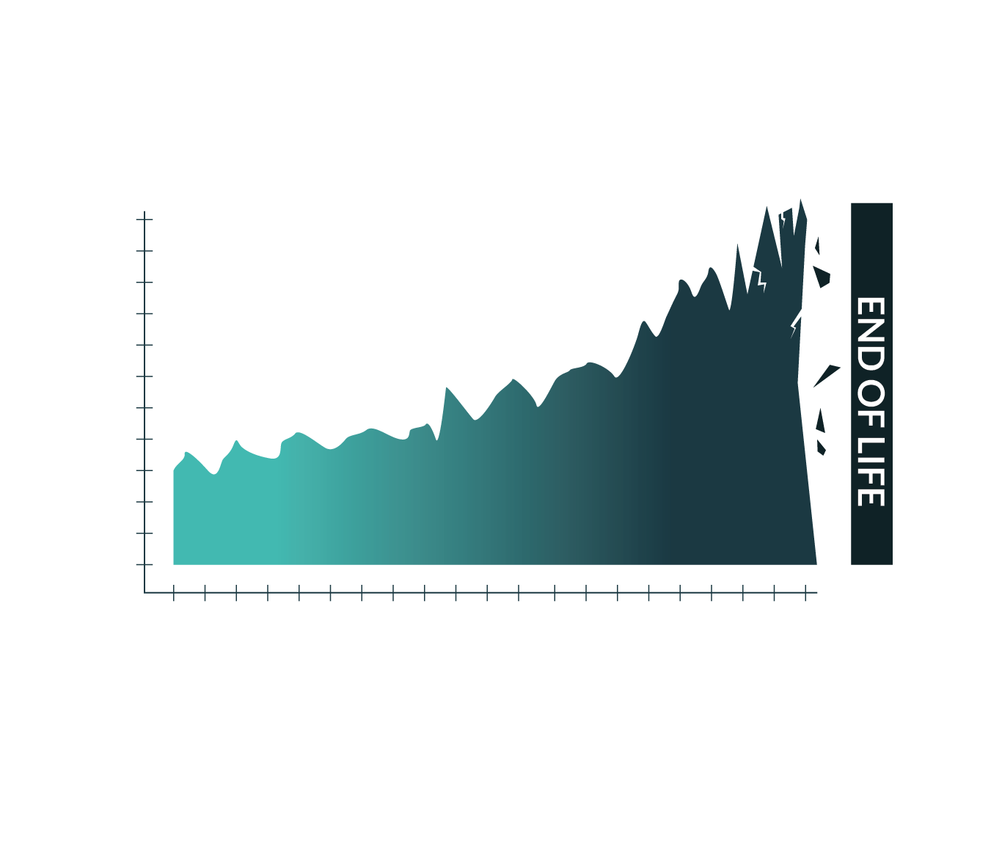
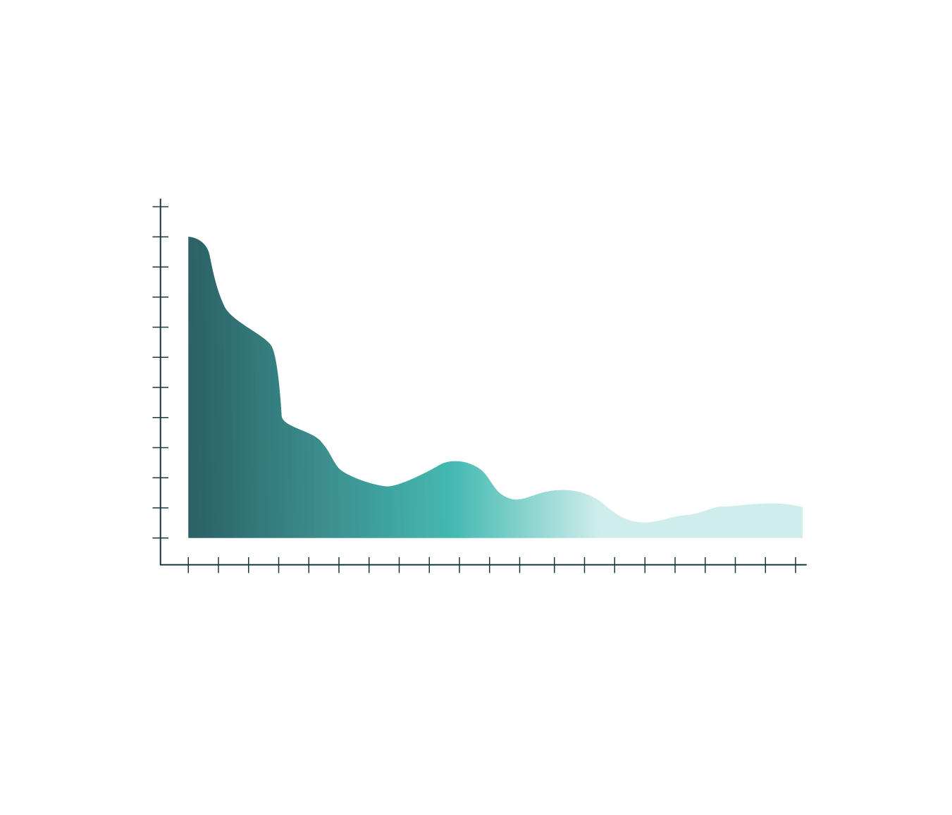
Cost Over Time
Plan for the centre
Plan to include the edge from the start

Slide 38
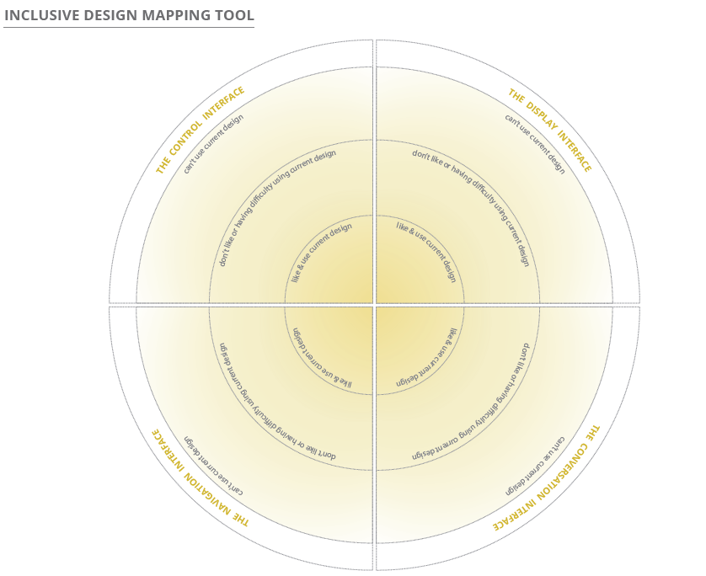
Who to engage..….
People that don’t like or have difficulty using the current design
People that hate or can’t use the current design
Inclusive Design Mapping Tool

Slide 39


Machines that understand, recognize and serve diversity….
Better able to
respond to unexpected
detect risk
adapt to change
transfer to new contexts
Greater longevity
May reduce disparity…
May lift us out of our current ruts…

Slide 40
Policy Implications2
Policy Implications
Gig Economy
First, a company procuring services or goods in the gig economy must determine whether it is considered an employer and the workers are considered employees. If yes, then the company is subject to Title I of the ADA (does not apply to independent contractors).
Second, even if there is no employer-employee relationship or employment agency-applicant relationship, the company is still required to provide equal opportunity in the selection of individual vendors, in its capacity as a public accommodation
Third, the entities establishing the marketplaces via web-based platforms may also be considered public accommodations and required to make their websites accessible to and usable by people with disabilities.
This is an area with emerging regulations and policies.
40
Notes:
40

Slide 41
Policy Implications
Section 503
A nationwide 7% workforce "utilization goal"— federal contractors and subcontractors should aim for 7% of their workforce to be people with disabilities
Federal contractors employ 1 in every 4 workers in America, so the new rules have the power to make a big difference
Contractors should invite applicants to voluntarily self-identify as an individual with a disability
What you should do about it:
Make sure you buy accessible and inclusive IT systems
Application systems, website, internal workplace technology
41
Notes:
41

Slide 42

Data Bias and Evidence Based Governance…
What should we fund?

Slide 43
Policy & Important questions for AI Governance.…
What happens to the unrepresented and the under-represented?
How do we fare in competitive decisions?
How do we fare in risk detection?
What happens when we dis-intermediate? No entity to regulate

Slide 44

No end to learning
world is changing
learning is never complete
truths we learn one year are no longer true the next
new forms of work each year

Slide 45
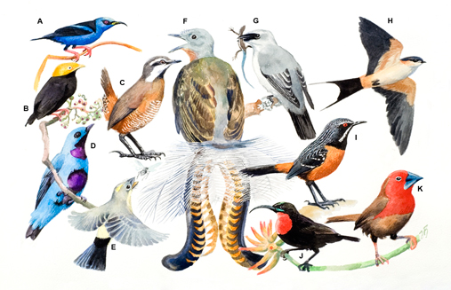
We need diverse learners
We need to treat human diversity as an important asset not an issue
We do not need carbon copies of graduates

Slide 46
We do need…
diverse perspectives
diverse learners
critical thinking
creativity and innovation
collaboration & teamwork
navigators of complexity

Slide 47
Education must:
View learning as life-long and not a staged set of age-linked grades or degrees;
Empower learners to assess and guide their own learning;
Value and recognize a diversity of skills and competencies that is potentially as diverse as the diversity of learners; and
Support collaboration and collective production over competition with others.

Slide 48
Resources
Josh Christianson
jchristianson@peatworks.org
www.peatworks.org
Learn more about Gig economy and AI: http://www.peatworks.org/futureofwork
Ensure your practices are inclusive: http://www.peatworks.org/talentworks
Buy technologies that are accessible: http://www.peatworks.org/Buy-IT
Understand implications of policy: http://www.peatworks.org/policy-matters
Jutta Treviranus
jtreviranus@ocadu.ca
https://idrc.ocadu.ca
Inclusive Design Guide: https://guide.inclusivedesign.ca
Platform Co-op Development Kit: https://platform.coop
Race to the Edge: https://deep.idrc.ocadu.ca
Notes:
Show them on the website

